Slide 1
AS91896[2.7] AS91887[2.8] Documentation
[Peter McKay]

Slide 2
[Monster_Cards_Internal]
Link to GitHub Repository:
[https://github.com/peter123321123321/Monster-Cards-Internal]
Links to Trello board / project management tools:
[https://trello.com/b/HvmDrkWJ/monstercardsinternal]
Link to final version of your program:
[https://github.com/peter123321123321/Practice-Internal/blob/main/Final_VersionV2.py]
Ensure you have made these links ‘public’ so that they are open to anyone, including the marker. The link to your program is the final outcome of this whole project – your finished program.

Slide 3
Explain relevant Implications:
Additional rows can be added by clicking in the last cell and then using the Tab key
Relevant implication | Explain the implication and say how it is relevant to this project
Usability | Usability is about making the program as easy to use as possible for the largest number of users. It considers things like are instructions clear so that the user can avoid and correct errors, and does it tell the user what is currently happening. It is important to minimize or eliminate frustration by eliminating the things that could cause frustration.
Functionality | Functionality is making sure that the outcome works as intended. It should work for expected, unexpected, and boundary cases. For example, if the user is asked to input yes or no when asked a question. Along with expected cases, e.g., yes or no it. It should also works as intended If the user inputs unexpected cases, e.g., maybe or 1234. Another part of functionality is making the code as efficient as possible. This can be done by breaking large code problems into multiple subproblems.
Notes:
Additional rows can be added by clicking in the last cell and then using the Tab key

Slide 4
Explain relevant Implications:
Additional rows can be added by clicking in the last cell and then using the Tab key
Relevant implication | Explain the implication and say how it is relevant to this project
Future proofing | As technology develops digital systems and programs will quickly become obsolete or inefficient which is why its important to future proof your project to make sure its easy to edit, change and improve in the case it needs to be. You can do this by annotating your code (writing down what each part of the program does). Splitting the program into smaller functions that can be edited easily without affecting the entire program and many others
Aesthetics | Aesthetics is the overall look of the program and making the outcome pleasing to look at/use. A program with proper spacing prompts and decoration will be more aesthetic than one without and be easier for a user to navigate. when thinking about aesthetics you should consider things like, Is it well laid out, Does it follow design conventions, does it reduce unused information. So that it has a cleaner look.
Notes:
Additional rows can be added by clicking in the last cell and then using the Tab key

Slide 5
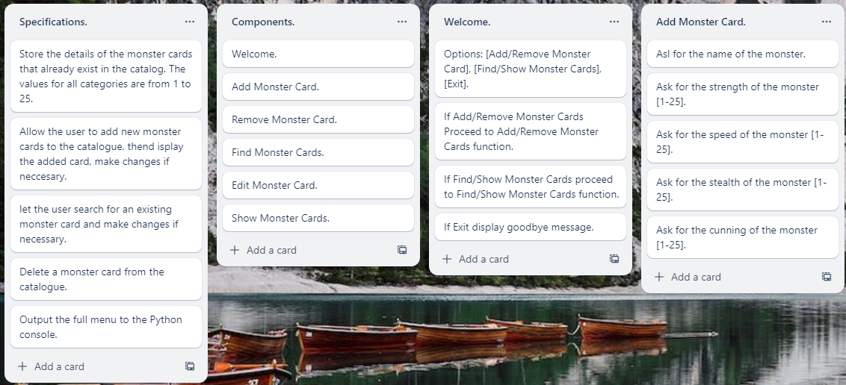
Decomposition:
Paste screenshots of your initial Trello board / task decomposition on this slide. If you have a long list, you might need to break it up into several slides.
Notes:
Paste screenshots of your initial Trello board / task decomposition on this slide. If you have a long list, you might need to break it up into several slides.

Slide 6
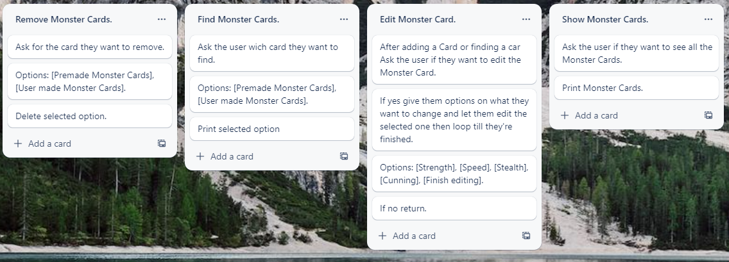
Decomposition:
Paste screenshots of your initial Trello board / task decomposition on this slide. If you have a long list, you might need to break it up into several slides.
Notes:
Paste screenshots of your initial Trello board / task decomposition on this slide. If you have a long list, you might need to break it up into several slides.

Slide 7
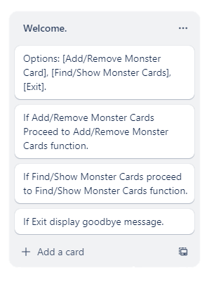
[Welcome] (Trello screenshot)

Slide 8
[Welcome] - Test Plan
Additional rows can be added by clicking in the last cell and then using the Tab key
Test Cases - input | Expected output
Add MONSTER | add_monster()
Remove MONSTER | remove_monster()
Find Show | Find_show()
Exit | Exit()
Notes:
Additional rows can be added by clicking in the last cell and then using the Tab key

Slide 9
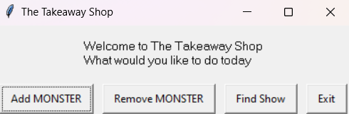
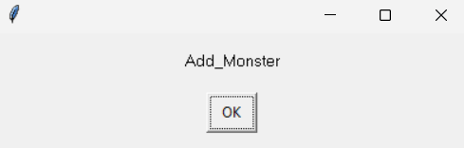
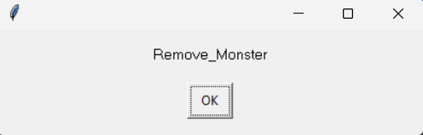
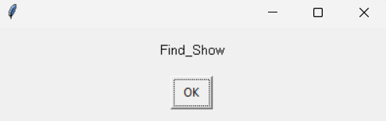
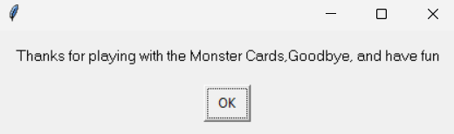
[Welcome]: Testing
You must show the results of testing. For each component, include a screenshot proving it works. You can also include notes about each test.
Placeholders just to test that it was working
Test Cases - input | Expected output
Add MONSTER | add_monster()
Remove MONSTER | remove_monster()
Find Show | Find_show()
Exit | Exit()
Notes:
You must show the results of testing. For each component, include a screenshot proving it works. You can also include notes about each test.

Slide 10
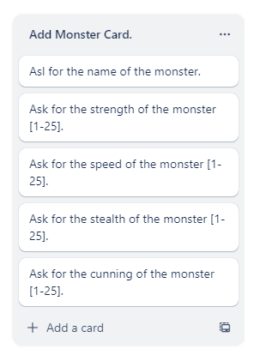
[Add Monster Cards] (Trello screenshot)

Slide 11
[Add Monster Cards] - Test Plan
I decided not to let the program accept floats as a value for the monster stats because none of the premade monsters have decimals
Test Cases - input | Expected output
Enter the Monster Name 1. Cancel 2. Stoneling 3. Peter | Return to welcome Name is already taken Adds name to dictionary
Monster Strength 1. Cancel 2. 21 | 1. returns to welcome 2. Adds Strength stat to dictionary
Monster Speed 1. 29 2. 2 | 1. Error message (above upperbound of 25) 2. Adds Speed stat to dictionary
Monster Stealth 1. 0 2. 13 | 1. Error message (below lowerbound of 1) 2. Adds Stealth stat to dictionary
Monster Cunning 1.5 and one 24 | Adds Cunning stat to dictionary 1. 1. Error message (Value not an integer) 2. Adds Cunning stat to dictionary
Notes:
Additional rows can be added by clicking in the last cell and then using the Tab key

Slide 12
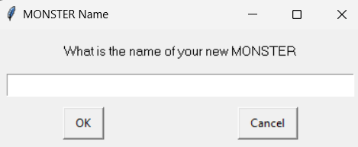
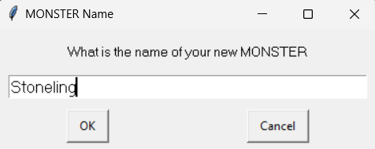
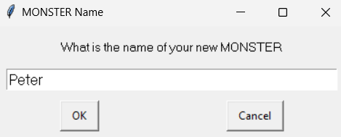
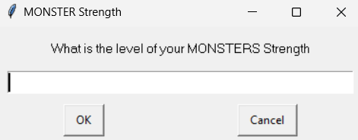
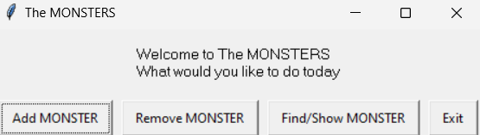
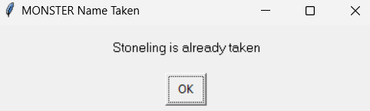
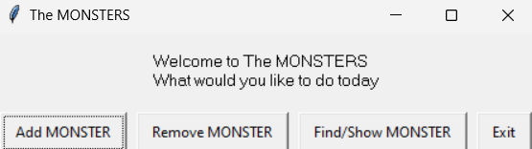
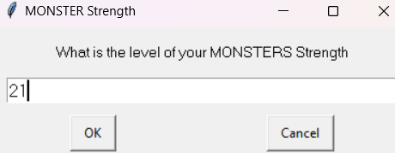
[Add Monster Cards]: Testing
You must show the results of testing. For each component, include a screenshot proving it works. You can also include notes about each test.
Test Cases - input | Expected output
Enter the Monster Name 1. Cancel 2. Stoneling 3. Peter | Return to welcome Name is already taken Adds name to dictionary
Monster Strength 1. Cancel 2. 21 | 1. returns to welcome 2. Adds Strength stat to dictionary
Notes:
You must show the results of testing. For each component, include a screenshot proving it works. You can also include notes about each test.

Slide 13
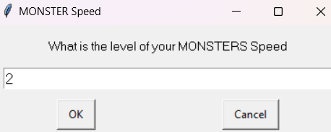
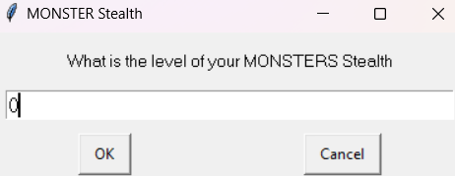
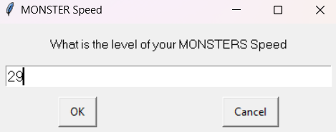
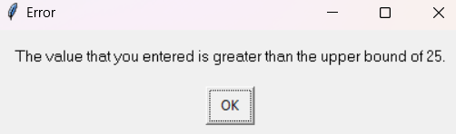
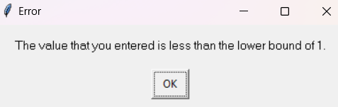
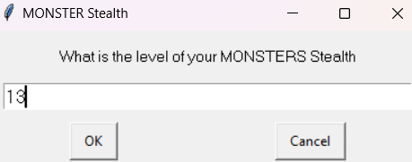
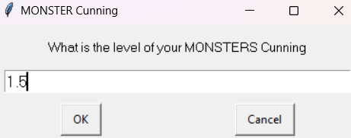
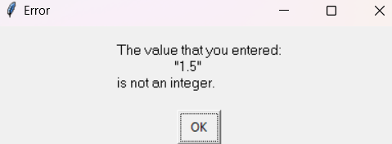
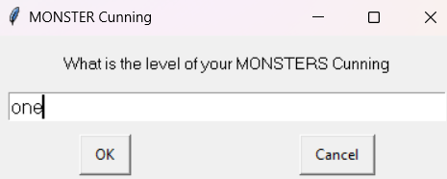
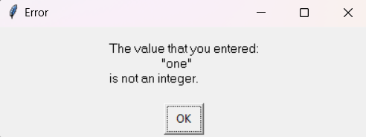
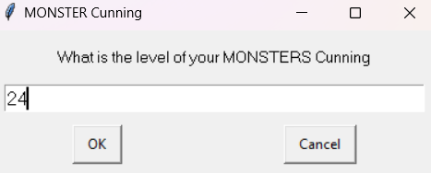
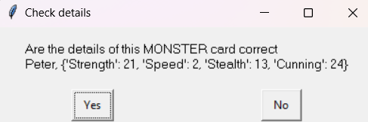
[Add Monster Cards]: Testing
You must show the results of testing. For each component, include a screenshot proving it works. You can also include notes about each test.
Test Cases - input | Expected output
Monster Speed 1. 29 2. 2 | 1. Error message (above upperbound of 25) 2. Adds Speed stat to dictionary
Monster Stealth 1. 0 2. 13 | 1. Error message (below lowerbound of 1) 2. Adds Stealth stat to dictionary
Monster Cunning 1.5 and one 24 | Adds Cunning stat to dictionary 1. 1. Error message (Value not an integer) 2. Adds Cunning stat to dictionary
Notes:
You must show the results of testing. For each component, include a screenshot proving it works. You can also include notes about each test.

Slide 14
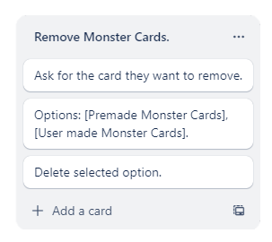
[Remove Monster Cards] (Trello screenshot)

Slide 15
[Remove Monster Cards] - Test Plan
Additional rows can be added by clicking in the last cell and then using the Tab key
Test Cases - input | Expected output
What Monster Card would you like to Delete | Show Options
Premade cards | Delete selected Card
User made cards | Delete selected Card
Return | Return to welcome function
Notes:
Additional rows can be added by clicking in the last cell and then using the Tab key

Slide 16
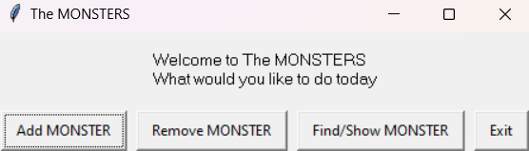
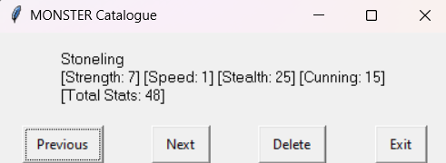
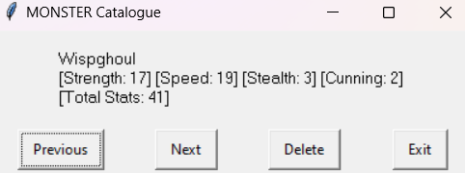
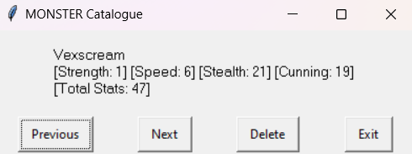
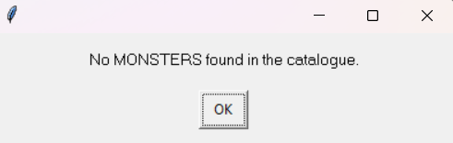
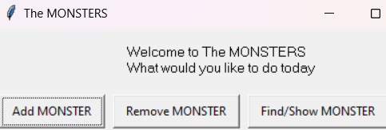
[Remove Monster Cards]: Testing
You must show the results of testing. For each component, include a screenshot proving it works. You can also include notes about each test.
Test Cases - input | Expected output
What Would you like to do today [Welcome] -Remove MONSTERS | Show first monsters details
Previous | Go to the previous monster
Next | Go to the next monster
Delete -Delete every monster | Delete current card There are no monsters in this catalogue
Exit | Return to welcome function
Z
Z
Z
Notes:
You must show the results of testing. For each component, include a screenshot proving it works. You can also include notes about each test.

Slide 17
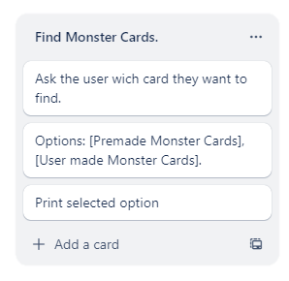
[Find Monster Cards] (Trello screenshot)

Slide 18
[Find Monster Cards] - Test Plan
Additional rows can be added by clicking in the last cell and then using the Tab key
Test Cases - input | Expected output
Would you like to view a MONSTER or Show all MONSTERS -Find MONSTERS | Proceed to show monsters Show Options
What Monster Card would you like to view -Premade card -User made card | Show details of selected monster
Exit | Return to welcome function
Notes:
Additional rows can be added by clicking in the last cell and then using the Tab key

Slide 19
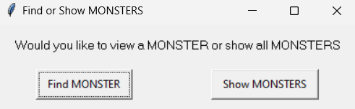
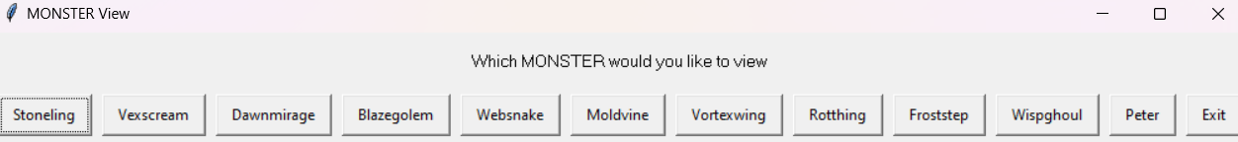
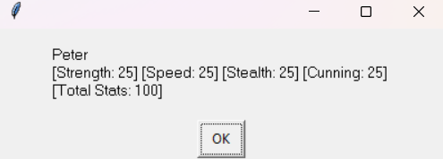
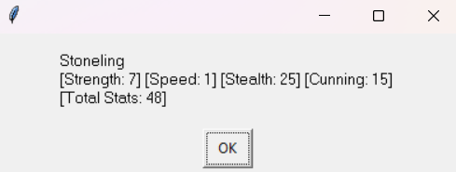
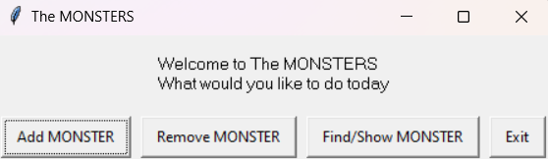
[Find Monster Cards]: Testing
Test Cases - input | Expected output
Would you like to view a MONSTER or Show all MONSTERS -Find MONSTERS | Proceed to show monsters Show Options
What Monster Card would you like to view -Premade card -User made card | Show details of selected monster
Exit | Return to welcome function
Notes:
You must show the results of testing. For each component, include a screenshot proving it works. You can also include notes about each test.

Slide 20
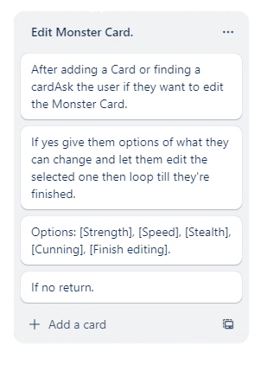
[Edit Monster Card] (Trello screenshot)

Slide 21
[Edit Monster Cards] - Test Plan
Same component used in Find MONSTER and Add MONSTER
Test Cases - input | Expected output
Are the details of this card correct -No | Print MONSTER details proceed to edit monster
Which stat would you like to edit: (strength, speed, stealth, cunning, Name) | Edit selected trait
Monster Name 1. Cancel 2. MONSTER1 | 1. Return to welcome 2. Adds name to dictionary
Notes:
Additional rows can be added by clicking in the last cell and then using the Tab key

Slide 22
[Edit Monster Cards] - Test Plan
Same component used in Find MONSTER and Add MONSTER
Test Cases - input | Expected output
Monster Strength 1. Cancel 2. 21 | 1. returns to welcome 2. Adds Strength stat to dictionary
Monster Speed 1. 29 2. 2 | 1. Error message (above upperbound of 25) 2. Adds Speed stat to dictionary
Monster Stealth 1. 0 2. 13 | 1. Error message (below lowerbound of 1) 2. Adds Stealth stat to dictionary
Monster Cunning 1.5 and one 24 | Adds Cunning stat to dictionary 1. 1. Error message (Value not an integer) 2. Adds Cunning stat to dictionary
Notes:
Additional rows can be added by clicking in the last cell and then using the Tab key

Slide 23
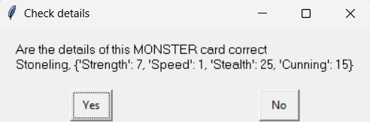
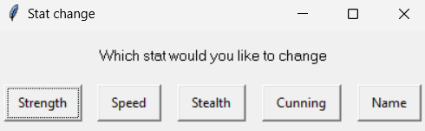
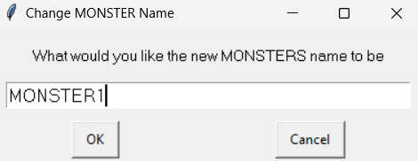
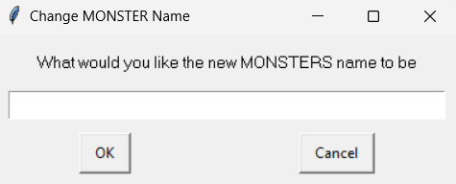
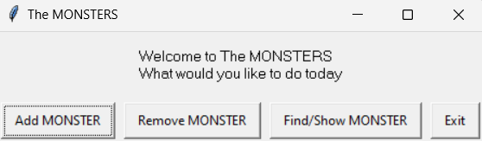
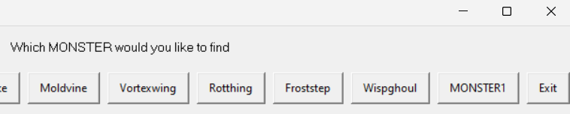
[Edit Monster Cards]: Testing
You must show the results of testing. For each component, include a screenshot proving it works. You can also include notes about each test.
Test Cases - input | Expected output
Are the details of this card correct -No | Print MONSTER details proceed to edit monster
Which stat would you like to edit: (strength, speed, stealth, cunning, Name) | Edit selected trait
Monster Name 1. Cancel 2. MONSTER1 | 1. Return to welcome 2. Adds name to dictionary
Notes:
You must show the results of testing. For each component, include a screenshot proving it works. You can also include notes about each test.

Slide 24
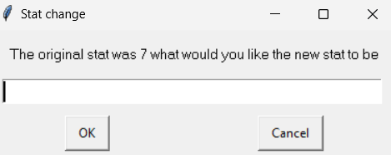


















[Edit Monster Cards]: Testing
You must show the results of testing. For each component, include a screenshot proving it works. You can also include notes about each test.
Test Cases - input | Expected output
Monster Strength 1. Cancel 2. 21 | 1. returns to welcome 2. Adds Strength stat to dictionary
Monster Speed 1. 29 2. 2 | 1. Error message (above upperbound of 25) 2. Adds Speed stat to dictionary
Monster Stealth 1. 0 2. 13 | 1. Error message (below lowerbound of 1) 2. Adds Stealth stat to dictionary
Monster Cunning 1.5 and one 24 | Adds Cunning stat to dictionary 1. 1. Error message (Value not an integer) 2. Adds Cunning stat to dictionary
Notes:
You must show the results of testing. For each component, include a screenshot proving it works. You can also include notes about each test.

Slide 25

[Show Monster Cards] (Trello screenshot)

Slide 26
[Show Monster Cards] - Test Plan
Additional rows can be added by clicking in the last cell and then using the Tab key
Test Cases – input | Expected output
Would you like to View a MONSTER or Show all MONSTERS -Show MONTERS | Procced to Show Monsters
Previous | Go to the previous monster
Next | Go to the next monster
Exit | Return to welcome
Notes:
Additional rows can be added by clicking in the last cell and then using the Tab key

Slide 27






[Show Monster Cards]: Testing
You must show the results of testing. For each component, include a screenshot proving it works. You can also include notes about each test.
Test Cases – input | Expected output
Would you like to View a MONSTER or Show all MONSTERS -Show MONTERS | Procced to Show Monsters
Previous | Go to the previous monster
Next | Go to the next monster
Exit | Return to welcome
Notes:
You must show the results of testing. For each component, include a screenshot proving it works. You can also include notes about each test.

Slide 28


[Show_Monster]: Trialling
NOTE: Trialling needs to happen for at least 2 of your components but is not necessary for ALL components.
Trialling is not the same as testing. Trialling is about finding different ways of building the same component. Show evidence of your trialling here. Select one of your trials for further development and give reasons for your choice.
RED BOX
This code has a monster index set at 0 which represents the current monster being displayed. The code has a while loop with each loop storing each monster's name, stats (using a for loop to go through each of the monsters' stats and add them) and total stats which is then displayed to the user. The user is asked what they would like to do using a button box with the choices “Previous”, “Next” and “Exit”. If the user selects previous it will minus one from the monster index and move to the previous monster. If the user selects next it will plus on to the monster index and more to the next monster. If the user selects exit the loop will stop and the program will end.
BLUE BOX
This code uses a button box to ask the user if they would like to view the monsters. giving 2 choices, “Yes” or “No”. Choosing “Yes” makes the code print each monsters' stats in the cards dictionary. Choosing “No” stops the loop.
I chose to further develop the Red box. Although the blue box is a lot simpler and smaller overall it is more difficult for the user to use as the number of monsters in the dictionary is very large not including any user added ones and since this code displays them all it once it's very difficult for the user to be able to find what they are looking for without being distracted by the other 12 monster details. The code in the red box lets you look through each monster one by one and is well formatted and user friendly unlike the blue box as well as outputting to easy Gui instead of the python console which is more in tune with what else is used in the program. Therefore, I've decided to further develop the code in the Red box as its more cohesive with my code and is overall better.
Notes:
NOTE: Trialling needs to happen for at least 2 of your components but is not necessary for ALL components.
Trialling is not the same as testing. Trialling is about finding different ways of building the same component. Show evidence of your trialling here. Select one of your trials for further development and give reasons for your choice.

Slide 29


[Add_Monster]: Trialling
RED BOX
This code is in a while loop letting them add combos till, they exit. The user is asked what the name of the monster is as well as the values of the monsters Strength, Speed, Stealth and Cunning. Using an enter box for the name and a integer box for the stats. The entered values are all added to a dictionary. The user is displayed the monsters detailed and asked which stat they would like to change with all the stats listed and the option to exit. The code uses elif statements to see which stat the user chooses, and they are asked what the new value is which is then added to the dictionary.
BLUE BOX This code asks the user what the name of the monster is and adds it to the dictionary. It then uses a for loop to cycle through the different stats asking the user for the value for each stat and then adding it to the dictionary. It then displays the monster details and ask whether the monster details are correct and while they don’t say yes it will loop through asking them which stat they would like to change and what they would like the new value to be. It then changes it in the dictionary.
I have decided to further develop the code in the blue box. This is due to the code being a lot shorter and more efficient compared to the other code. The code in the red box uses a lot of elif statements making the code quite long while the blue code uses for statements that can loop the code and do the same thing using a lot less room. As well as it being much easier to edit as instead of having to add in new elif statements and stats anytime you want to do something, in the blue code you can just add an option in the choices and it will loop through and let the user add it to the dictionary. Therefore I think its better to use the blue code as It has a lot more development potential and ways to make my code more efficient and useful plus its reusable in other areas of my code like the find card function where you can edit the code.
Notes:
NOTE: Trialling needs to happen for at least 2 of your components but is not necessary for ALL components.
Trialling is not the same as testing. Trialling is about finding different ways of building the same component. Show evidence of your trialling here. Select one of your trials for further development and give reasons for your choice.

Slide 30
Assembled Outcome Testing:1
Show testing for your assembled outcome below. This should include a test plan followed by screenshot proof.
Test Plan - input | Expected output
What would you like to do today -Add_monster | Add_monster()
What is the name of your new monster MONSTER1 | Adds to dictionary
Monsters strength 1 | Adds to dictionary
Monsters speed 0 29 3 | Error message Error message Adds to dictionary
Monsters stealth 1.5 2 | Error message Adds to dictionary
Monsters strength One 1 | Error message Adds to dictionary
Notes:
Show testing for your assembled outcome below. This should include a test plan followed by screenshot proof.

Slide 31














Assembled Outcome Testing: 1
Show testing for your assembled outcome below. This should include a test plan followed by screenshot proof.
Test Plan - input | Expected output
What would you like to do today -Add_monster | Add_monster()
What is the name of your new monster MONSTER1 | Adds to dictionary
Monsters strength 1 | Adds to dictionary
Monsters strength 0 29 3 | Error message Error message Adds to dictionary
Monsters strength 1.5 2 | Error message Adds to dictionary
Monsters strength One 1 | Error message Adds to dictionary
Notes:
Show testing for your assembled outcome below. This should include a test plan followed by screenshot proof.

Slide 32
Assembled Outcome Testing:2
Show testing for your assembled outcome below. This should include a test plan followed by screenshot proof.
Test Plan - input | Expected output
Are the details correct -NO | Proceed to edit monster
Which stat would you like to change | Proceed to whichev rstat user chose
Strength 0 26 1 | Error message Error message Add to dictionary
Speed One 1 | Error message Add to dictionary
Name monster | Add to dictionart
Are the details cored - yes | Return to welcome
Notes:
Show testing for your assembled outcome below. This should include a test plan followed by screenshot proof.

Slide 33













Assembled Outcome Testing: 2
Test Plan - input | Expected output
Are the details correct -NO | Proceed to edit monster
Which stat would you like to change | Proceed to whichev rstat user chose
Strength 0 26 1 | Error message Error message Add to dictionary
Speed One 1 | Error message Add to dictionary
Name monster | Add to dictionart
Are the details cored - yes | Return to welcome
Notes:
Show testing for your assembled outcome below. This should include a test plan followed by screenshot proof.

Slide 34
Assembled Outcome Testing:3
Show testing for your assembled outcome below. This should include a test plan followed by screenshot proof.
Test Plan - input | Expected output
What would you like to do today -Remove monster | Remove_monster)
Previous | Goes to previous monster
Next | Goes to next monster
Delete | Deletes current monster
exit | Return to welcome function
Notes:
Show testing for your assembled outcome below. This should include a test plan followed by screenshot proof.

Slide 35






Assembled Outcome Testing: 3
Show testing for your assembled outcome below. This should include a test plan followed by screenshot proof.
Test Plan - input | Expected output
What would you like to do today -Remove monster | Remove_monster)
Previous | Goes to previous monster
Next | Goes to next monster
Delete | Deletes current monster
exit | Return to welcome function
Notes:
Show testing for your assembled outcome below. This should include a test plan followed by screenshot proof.

Slide 36
Assembled Outcome Testing:4
Show testing for your assembled outcome below. This should include a test plan followed by screenshot proof.
Test Plan - input | Expected output
What would you like to do today -find/show monster | Find_show()
Would you like to view or show all monsters show monster | Proceed to show monster
Which monster would you like to find | Proceed to whichever monster you choose
Are the details of this monster correct Yes -no | return to welcome function Proceed to edit monster
Notes:
Show testing for your assembled outcome below. This should include a test plan followed by screenshot proof.

Slide 37




Assembled Outcome Testing: 4
Show testing for your assembled outcome below. This should include a test plan followed by screenshot proof.
Test Plan - input | Expected output
What would you like to do today -find/show monster | Find_show()
Would you like to view or show all monsters Find monster | Proceed to find monster
Which monster would you like to find | Proceed to whichever monster you choose
Are the details of this monster correct Yes -no | return to welcome function Proceed to edit monster
Notes:
Show testing for your assembled outcome below. This should include a test plan followed by screenshot proof.

Slide 38
Assembled Outcome Testing:5
Show testing for your assembled outcome below. This should include a test plan followed by screenshot proof.
Test Plan - input | Expected output
Which stat would you like to change | Proceed to whichev rstat user chose
Strength 0 26 1 | Error message Error message Add to dictionary
Speed One 1 | Error message Add to dictionary
Name monster | Add to dictionart
Are the details cored - yes | Return to welcome
Notes:
Show testing for your assembled outcome below. This should include a test plan followed by screenshot proof.

Slide 39
Assembled Outcome Testing: 5 (same as 2 as they use the same edit component)
Test Plan - input | Expected output
Which stat would you like to change | Proceed to whichev rstat user chose
Strength 0 26 1 | Error message Error message Add to dictionary
Speed One 1 | Error message Add to dictionary
Name monster | Add to dictionart
Are the details cored - yes | Return to welcome
Notes:
Show testing for your assembled outcome below. This should include a test plan followed by screenshot proof.

Slide 40
Assembled Outcome Testing: 6
Show testing for your assembled outcome below. This should include a test plan followed by screenshot proof.
Test Plan - input | Expected output
Would you like to view or show all monsters show monster | Proceed to find monster
What would you like to do today -Remove monster | Remove_monster)
Previous | Goes to previous monster
Next | Goes to next monster
exit | Reutnr to welcome function
exit | Show exit message
Notes:
Show testing for your assembled outcome below. This should include a test plan followed by screenshot proof.

Slide 41







Assembled Outcome Testing: 6
Show testing for your assembled outcome below. This should include a test plan followed by screenshot proof.
Test Plan - input | Expected output
Would you like to view or show all monsters show monster | Proceed to find monster
What would you like to do today -Remove monster | Remove_monster)
Previous | Goes to previous monster
Next | Goes to next monster
exit | Reutnr to welcome function
exit | Show exit message
Notes:
Show testing for your assembled outcome below. This should include a test plan followed by screenshot proof.

Slide 42


Feedback
Show testing for your assembled outcome below. This should include a test plan followed by screenshot proof.
While I was having my mother test out my code and give me feedback the strongest complaint she had was with the way that my show monsters function was formatted as it changed from the easy gui function to the python console and also displayed a lot of information all at once. So to combat this I trialled this function and changed it from printing to the python console to the easy gui function and doing it in a way that was natural to her and other users. As there was a lot of information I decided to format it like a book with a previous next and exit buttons that seemed to work well with her and some of the other people that I got to try it.
Notes:
Show testing for your assembled outcome below. This should include a test plan followed by screenshot proof.

Slide 43
Address relevant Implications:
Relevant implication | Explain how your final outcome addresses each implication
Usability | To address the usability of my program I Reduced the need for user input by replacing user input with button boxes instead of making them input based off their memory and putting in the option to return instead of asking them if they were sure that’s what they wanted to do. This is especially useful when they're searching up combos as they won't be able to remember all the different combos so using a button box makes it easy to find all the options or when they must do the same thing a lot of times like adding monsters and don’t want to be asked if their sure multiple times
Functionality | I’ve addressed functionality in my code by reducing the need to check for boundary cases by using button boxes and Easy Gui's built in checks. they still have all the options they’d normally have but the human error is removed by allowing them to press buttons rather than type what they want in. this also make the code more functional as I don’t have to add as many checks to my code. I also reduced the amount of user input I needed so that the program was faster and more straight to the point as this is a code meant to build a database of monster codes and didn’t need much interaction.

Slide 44
Address relevant Implications:
Relevant implication | Explain how your final outcome addresses each implication
Aesthetics | To address the Aesthetics of my program I have for the show menu and other parts of the code formatted better so that its easier for user to discern what they're looking at. For the find function I made it so that you can choose which Monster you want to look at and then view its details and for the show menu function I made it so you can view one monster at a time then go back and forth looking at different one. I did this so it's easier to view the monsters because there are so many if you had to look at all of them at once it would be very time consuming and difficult to find what your looking for.
Future proofing | To help future proof my code I broke the program down into multiple functions so that it's easier to edit/remove/ add functions as well as creating dictionaries/lists to store Monster cards, names, stats so that its easily changeable in the future as well as usable in many different parts of the code. I also made sure to fully annotate my final version of the program so future programmers will know what each part of the code does

Slide 45


Version Control Evidence:
Notes:
Your version control evidence should go here. This could be in the form of screenshots (both of your GitHub repository as well as your local project folder) as evidence of your incremental development.

Slide 46


Version Control Evidence:
Notes:
Your version control evidence should go here. This could be in the form of screenshots (both of your GitHub repository as well as your local project folder) as evidence of your incremental development.

Slide 47
Final Discussion:
Discuss how the information from planning, testing and trialling of components assisted in the development of a high-quality outcome.
Planning(Trello):
Preplanning my program helped me break each problem down into smaller components and visualize the process of how they were going to work and giving me a plan of things that I needed to complete and add to my components to make it work. It helped increase the cohesiveness between each of the functions and saved me time on making all the functions work using one list and other variables. Overall, it helped me make my code much cleaner and made it easier to visualize and tick of parts of my program as I completed it helping me keep up to date with what I had to add and what was finished.
Testing:
Testing my code was crucial as I progressed through the development of my program. Creating multiple versions of each component allowed me to find errors easier as well as fix them without having to worry about effecting the entire program. By testing the program myself and getting others to test It I was able to discover potential errors easier and implement fixes to them to make sure that my code would working in many different scenarios. It also helped discover areas that could be improved or needed to be clearer e.g. my mother found my original show monster function impractical and difficult to read as well as find what she was looking for so I trialed it and changed it into something that was more natural (going page by page). This testing really helped me develop my code and make it work better for the users.
Trialing(show monster / add monster):
Im used to normally just doing my code one way and sticking with it but trying multiple ways of doing your code is very beneficial especially when you're code gets more complex as there's more things that can be changed more things that can be done differently and by trialing you can find these different ways of doing things that make your code better faster or more user friendly. I did this with multiple components including show monster and add combo each helping me develop those code as well as other especially with my add combo component as that helped me look at how I used my for loops differently and helped me implement them into my show monster component to format my monster details
Notes:
Discuss how the information from planning, testing and trialling of components assisted in the development of a high-quality outcome.

